Slide 1
Iteration 2 CSE 6324-Advance Topic in Software Engineering University of Texas at Arlington (UTA)
Project Title: Smart Contract Analysis Tool – using ANTLR
Team members:
1002031033
1002033432
1002026832
1001965572
1001911486
Shubham Arun Malankar
Nageshwar Ramkumar Jaiswal
Ravi Prakasha
Navyashree Budhihal Mutt
Rushikesh Mahesh Bhagat

Slide 2
Features that we worked on:
Challenges were faced in selecting the optimal programming language for analyzing smart contracts, as different languages have varying strengths and weaknesses.[8] [9]
The team utilized ANTLR as a highly effective parse generator to develop the tool. The tool uses a .G4 file to generate lexer.java, parser.java, and visitor.java files, which process the Solidity file and produce an Abstract Syntax Tree (AST). The tool ultimately reports detected vulnerabilities and errors.[1] [12]
We have created a tool to detect "too many digits" assigned to variable, zero address validation, incorrect address error and ambiguous version declaration by performing input validation on literal.

Slide 3




Design and Specification​:
.G4 FILLE
LEXER FILE
PARSER FILE
VISITOR FILE
SOURCE_UNIT
( JAVA CLASSES)
VULNERABILITIES DETECTED
SOLIDITY_FILE
AST
TOKEN
Fig 1. Workflow of the tool [1]

Slide 4
Design and Specification(cont.)​:
List of Inputs:
Solidity files. [7]
List of Output:
Vulnerabilities and Errors present in contract.

Slide 5
Tool and Technologies:
Eclipse [12]
Java 1.8 [3]
ANTLR 4.7.2 [1]

Slide 6
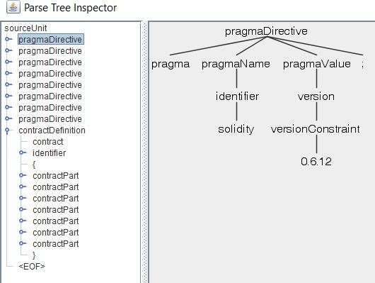
Outputs:
Fig 8: Screenshot showing the AST for version constraint.​

Slide 7
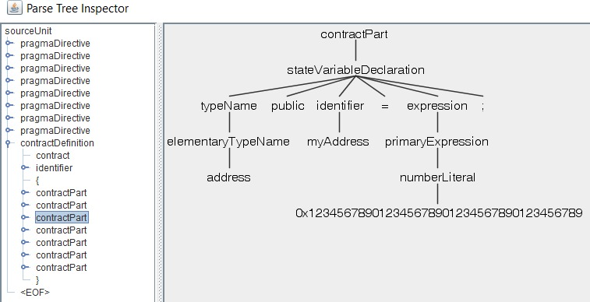
Outputs(cont.):
Fig 9: Screenshot showing the ast for number literal

Slide 8
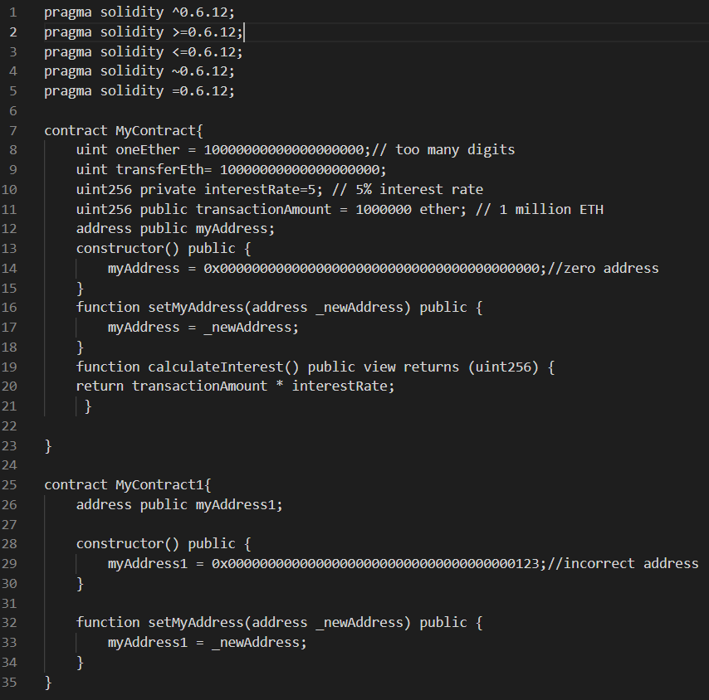
Test contract:
Fig.6 Screenshot of test contract that is used to test tool.

Slide 9
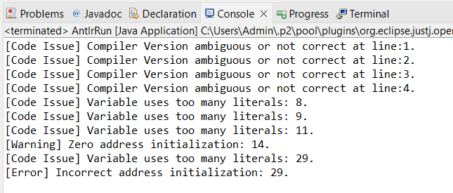
Outputs(cont..):
Fig 7: Screenshot showing the output showing vulnerabilities.

Slide 10
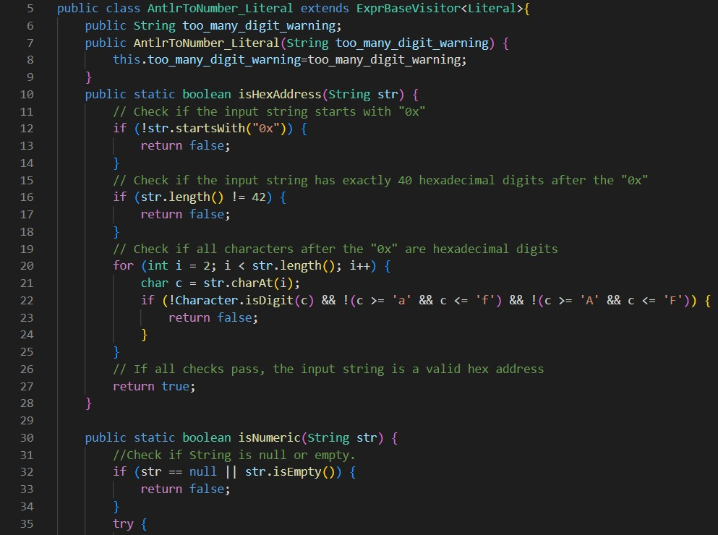
Code and Test contract:
Fig.2 Screenshot for zero-address check and too-many digits detection [6] [14]

Slide 11
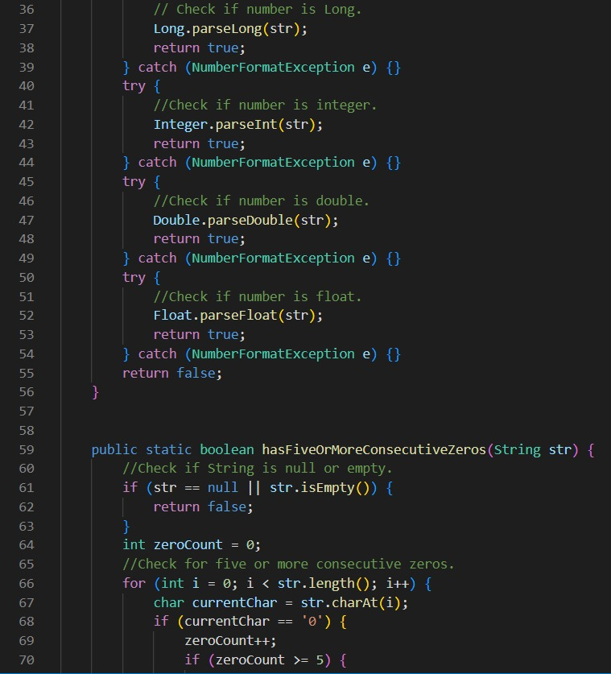
Code and Test contract (Cont.)
Fig.3 Screenshot for zero-address check and too-many digits detection [6] [14]

Slide 12
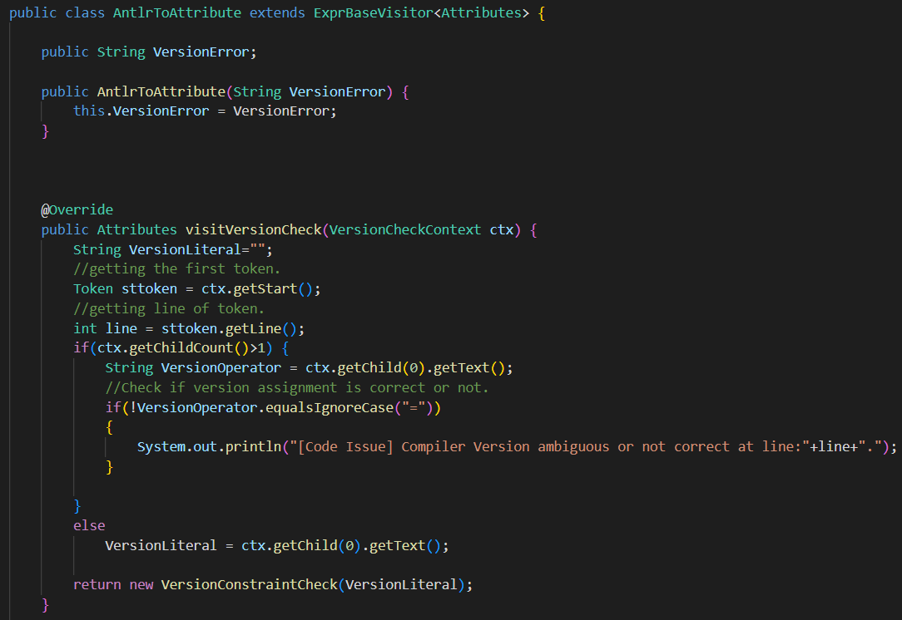
Code and Test contract (cont.):
Fig.4 Screenshot to check for ambiguous version detection in solidity [11]

Slide 13
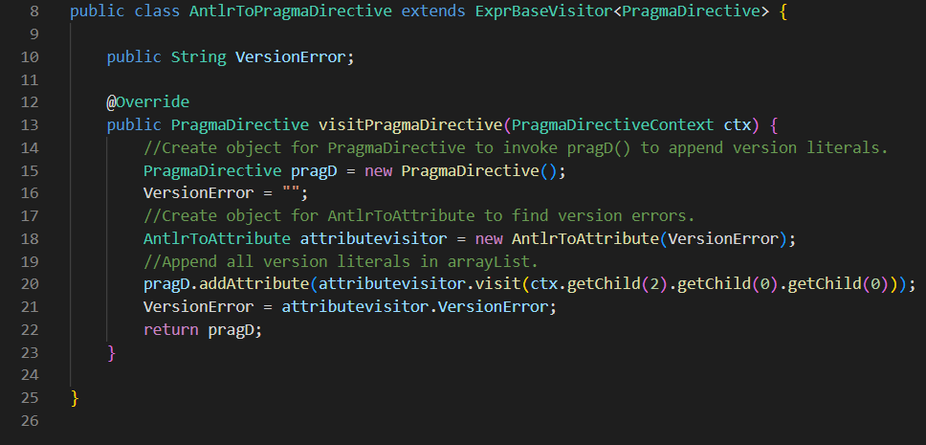
Code and Test contract (cont.):
Fig.5 Screenshot to check for ambiguous version detection in solidity [11]

Slide 14
Risks Faced During The Iteration :
Risks: | Type: | Mitigation:
Inadequate documentation for antlr | Minor | It is essential to ensure that any alterations or improvements made to a building or modification tool are clearly explained and detailed information is provided. Proper clarification is necessary, and documentation should be updated or committed whenever any changes or modifications are made.[1]
Visiting actual nodes of abstract syntax tree | Major | We debugged each output of the result and got our target literal on which we further worked upon.[7]
Finding test contract | Major | We found a reliable github repository which consist of test contract related to crypto currency, e-governance which aided our testing requirements. [5]
Antlr producing different results for different versions of JDK | Major | While setting the project environments, we need to take care of all the versions of JDK and jar files are compatible with each other.[1]
Setting up Antlr | Minor | We have followed the procedure, which are available on online resources. [12]

Slide 15
Customers and Users:
Importance of Solidity smart contract analysis tools:
Ensure security and functionality
Essential for developers
Benefits for local businesses using Solidity smart contract analysis tools:
Improve quality and reliability
Manage Ether and smart contracts
Darshan Ujjini Mallikarjuna's experience with Solidity analysis tool:
Valuable feedback provided
Practical experience with static analysis tool

Slide 16
Acknowledgement:
Darshan Ujjini Mallikarjuna – Block Chain Enthusiast

Slide 17
Github Repository:
https://github.com/shubhammalankar/ASE-CSE-6324-Team-5-Slither/tree/master/Iteration%202

Slide 18
References:
[1] https://www.antlr.org/
[2] https://www.eclipse.org/
[3] https://www.oracle.com/java/technologies/downloads/
[4] https://github.com/shubhammalankar/ASE-CSE-6324-Team-5-Slither/tree/master/Iteration%202
[5] https://github.com/OpenZeppelin/openzeppelin-contracts
[6] https://blackadam.hashnode.dev/zero-address-check-the-danger
[7] https://dev.to/lefebvre/compilers-101---overview-and-lexer-3i0m
[8] https://www.baeldung.com/java-antlr
[9] https://stackoverflow.com/questions/29971097/how-to-create-ast-with-antlr4
[10] https://www.geeksforgeeks.org/arraylist-in-java/
[11] https://ethereum.stackexchange.com/questions/96743/build-with-multiple-solc-versions
[12] https://www.youtube.com/watch?v=pa8qG0I10_I
[13] https://github.com/crytic/slither/wiki/Detector-Documentation#too-many-digits

Slide 19

Thank you!

